Slide 1


SAP UI5 & FIORI with OData TRAINING using BAS
Anubhav Oberoy
Day – 12

Slide 2

Agenda – Day 12
SAP Deployment Options
TCodes and Services
Data Model for our use case
Creating OData Service.
Building Get Entity set Method
Testing the Get Entity set Method in Browser
Building Get Entity method (Single Product)
Introduction to the Postman Tool
Setting the Authorization in Postman
Testing Get Entity and Entity set using Postman
Implementing Create in OData Service
Testing POST calls in the SAP Logon
Testing POST calls using postman
How to set payload in postman to test POST call
Introduction to x-csrf-token
Implementing Update and Delete in service

Slide 3





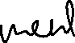











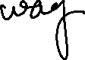






































Slide 4
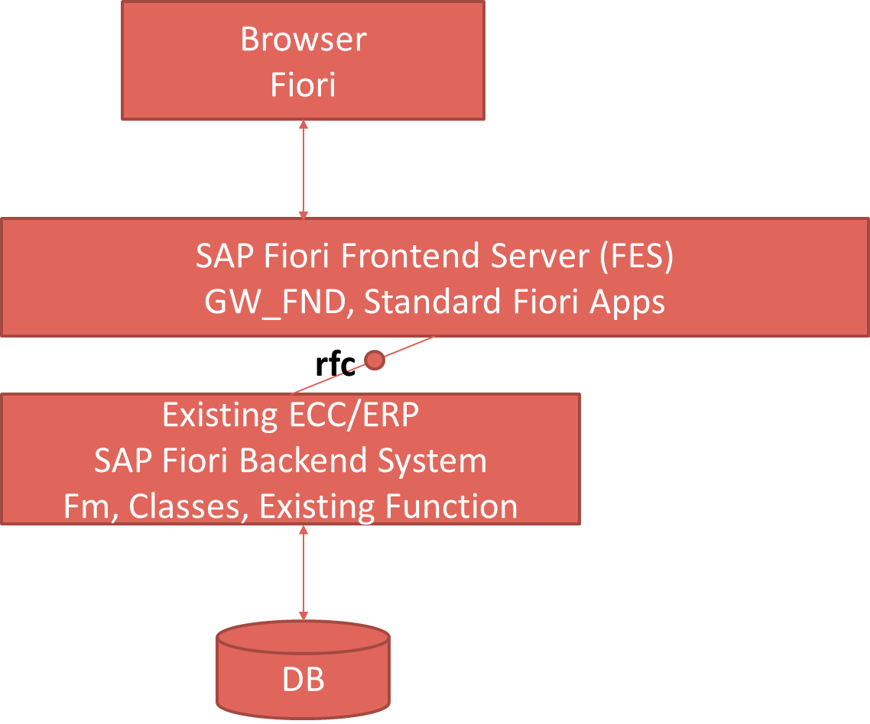

SAP Deployment Options
Central HUB Scenario
Embedded system
Browser
Fiori
SAP Fiori Frontend Server, GW_FND, Standard Fiori Apps
Existing ECC/ERP
SAP Fiori backend System
FM , Classes, existing Function
DB

Slide 5
Pros and Cons
Central HUB Deployment
Cons:
Manage multiple systems
Cost is high
Confusion
User needs to be duplicated
OData Metadata is duplicate
Pros
No need to upgrade
Separation of concerns
Works like a HUB
Recommendation
https://www.sap.com/documents/2018/02/f0148939-f27c-0010-82c7-eda71af511fa.html
Embedded Deployment (recommended)
Pros –
Less Costly
No confusion
No redundancy
Cons –
- Upgrade
- All load on one system

Slide 6
TCodes and Service
SEGW – SAP Service Gateway Builder
/n/IWFND/MAINT_SERVICE – Register the service
/n/IWFND/GW_CLIENT – gateway client – test locally
/n/IWFND/ERROR_LOG – Check errors, troubleshoot
EPM – Enterprise procurement model – Demo data model given by SAP for Training and demonstration.
ITeIO
SO
Customers
PO
Suppliers
Invoices
Stock

Slide 7
Data Model for our use case
EPM Data model = Enterprise Procurement Model
This is a sample data model for learning and education purpose since it is a demo model, we are not risking any productive objects in our system. The data model has Function Modules called as BAPI(Remote enabled FM).
All the BAPI starts with BAPI_EPM*
Products (SNWD_PD, SNWD_TEXTS)
BAPI_EPM_PRODUCT_GET_LIST – All the list of products
BAPI_EPM_PRODUCT_GET_DETAILS – Read single product by key
BAPI_EPM_PRODUCT_CREATE – Create new product
BAPI_EPM_PRODUCT_DELETE – Delete product
BAPI_EPM_PRODUCT_UPDATE – Change data of a product
Business Partners (SNWD_BPA)
BAPI_EPM_BP_GET_LIST – All the list of Business Partners
BAPI_EPM_ BP_GET_DETAILS – Read single Business Partners by key
BAPI_EPM_ BP_CREATE – Create new Business Partners
BAPI_EPM_ BP_DELETE – Delete Business Partners
BAPI_EPM_ BP_UPDATE – Change data of a Business Partners
Orders (SNWD_SO, SNWD_SO_I)

Slide 8
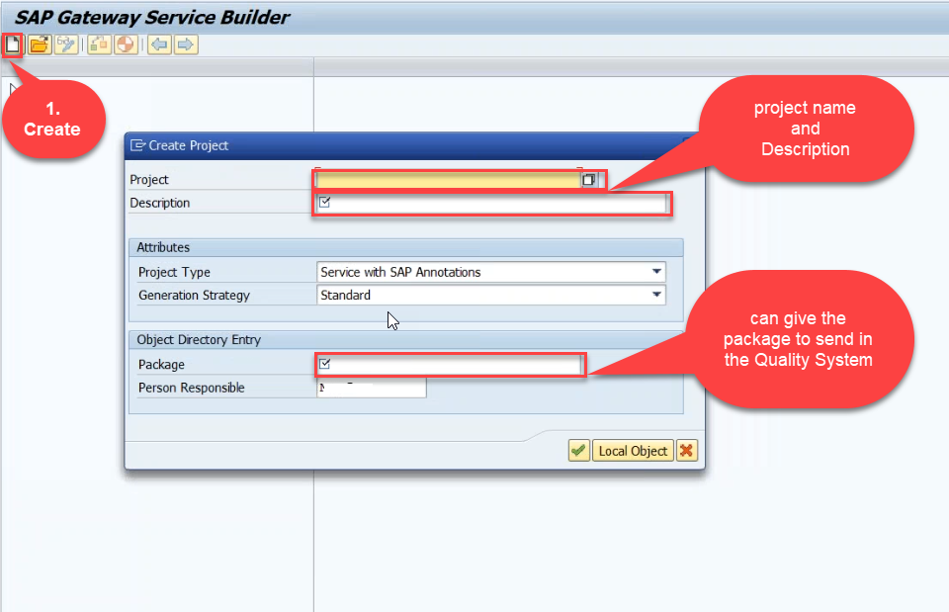
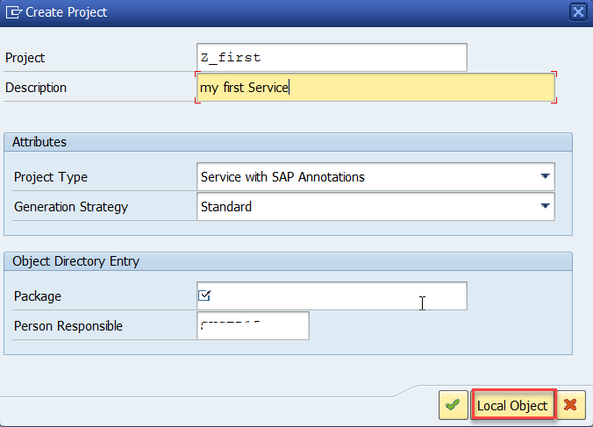
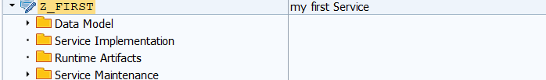
Creating OData Service Project
Step1: Start your SAP LOGON, and to Sap Gateway Service Builder(SEGW) and click on Create

Slide 9
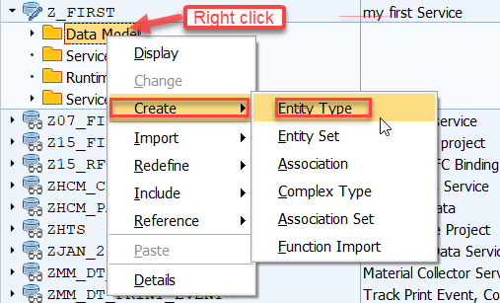
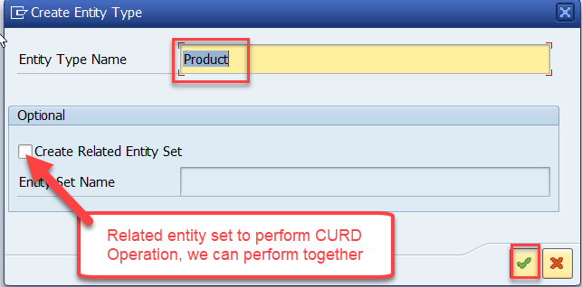
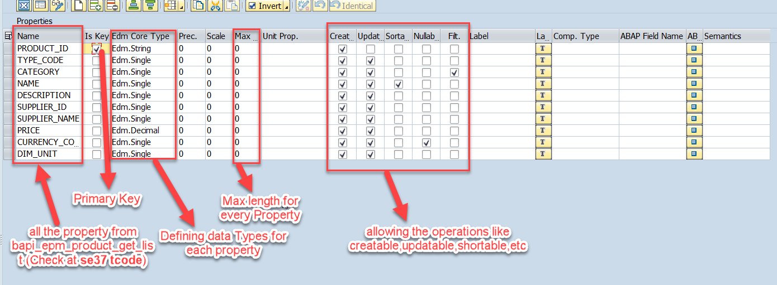
Creating OData Service Continue…
Step2: Defining the Data Model (Blueprint of data)
Step3: Creating Properties for data model (from bapi_epm_product_get_list (TCode- se37))

Slide 10



















Slide 11
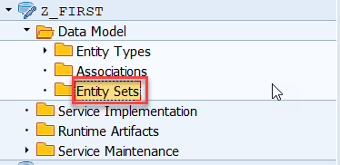
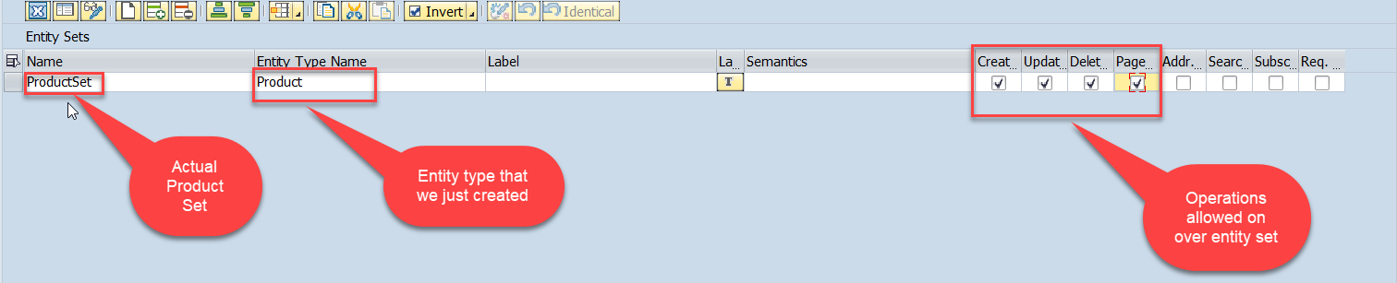
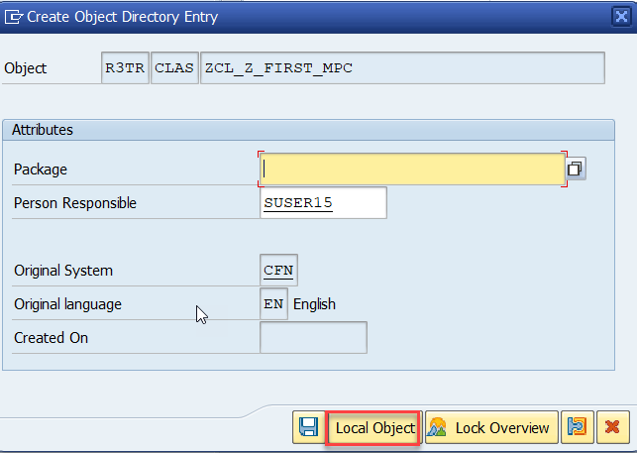
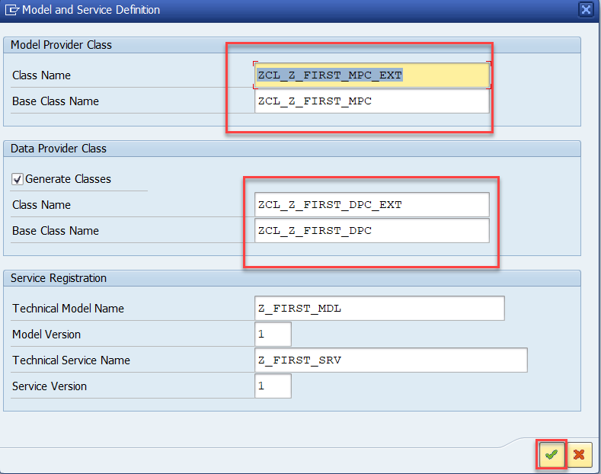
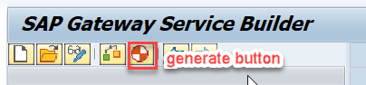
Creating OData Service Continue…
Step4: Creating entity set to perform actual CURD operations and service generation.
This is the name of your service

Slide 12
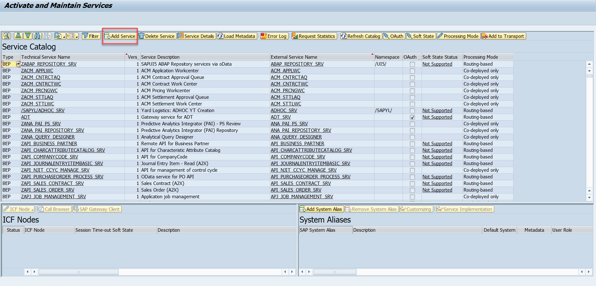
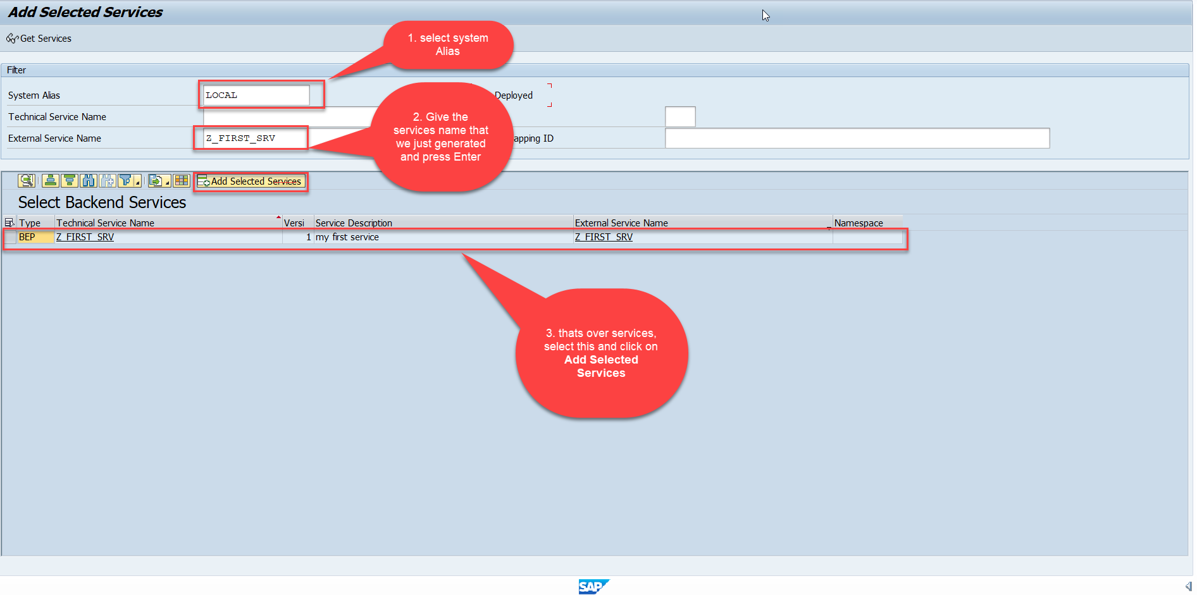
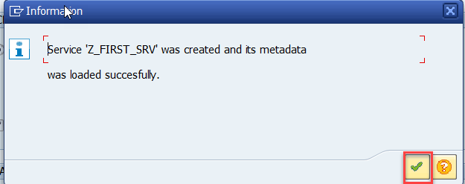
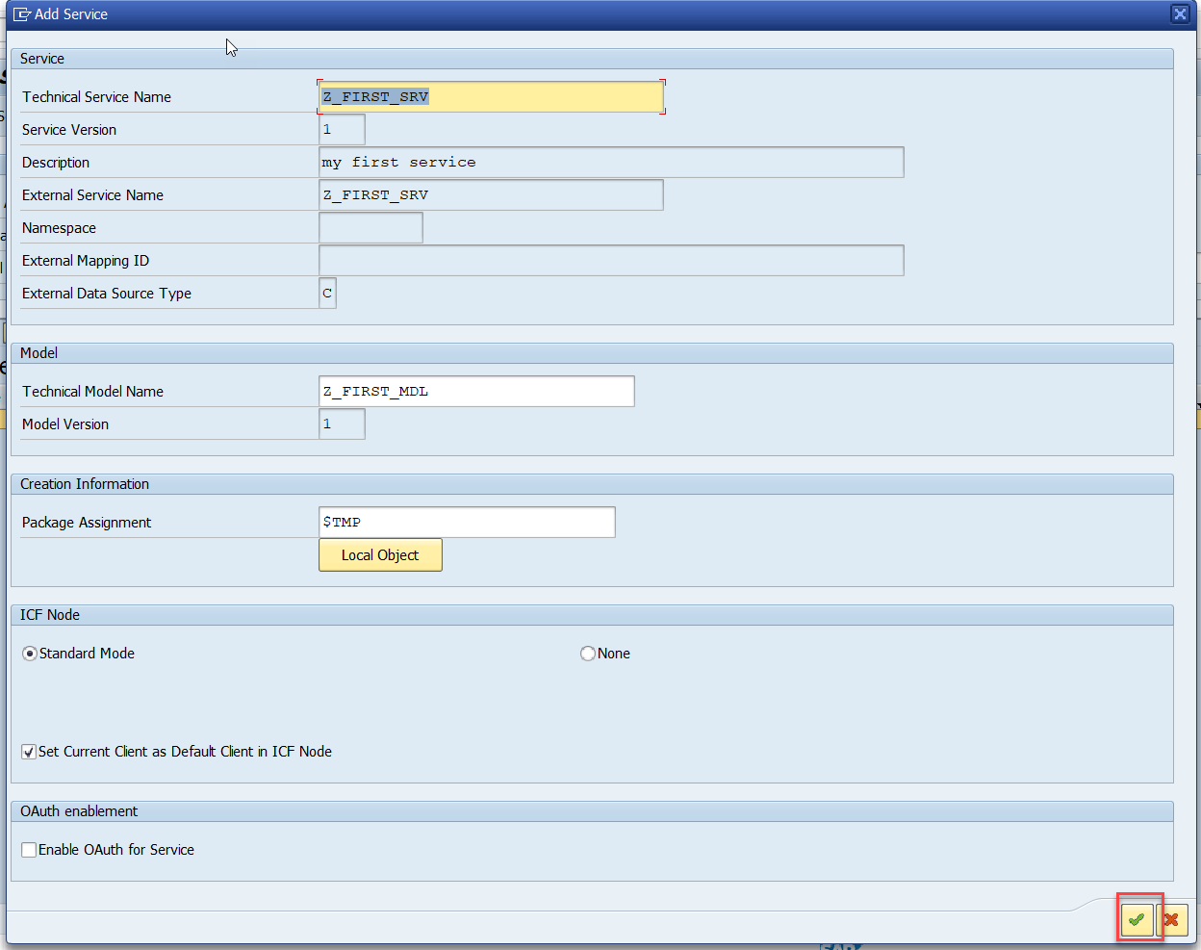
Creating OData Service Continue…
Step5: Service Registration (Go to tcode- /iwfnd/maint_service)

Slide 13
Hands-on: Creating First OData Service
Create your own first OData Service by following the steps written in the previous Slides.

Slide 14
Runtime Artifacts
When we create a service there are 2 types of code which developer/system needs
Metadata code – which serve metadata of the service, it will be generated by system automatically every time we change the service a new code will generate overwriting old code by SAP. This code is generated in MPC – model provider class
MPC = Model Provider Class (metadata) = where all the abap code will be generated which will have the code for metadata
Service Code – which is required as service implementation for performing CURDQ functionality. This code will be written by developer in a class called DPC = Data provider class.
DPC = Data Provider Class (data operations CRUDQ) = Contains all the implementation of CURDQ. It will get for each entityset 5 methods.
What if a developer need to customize the SAP generated code
SAP
Model provider class MPC class
Data Provider class
DPC class
Metadata
Types of entities
Whenever a entitySet is created, in Each entity 5 methods will be created –
OBJECT_GET_ENTITYSET
OBJECT_GET_ENTITY
OBJECT_CREATE_ENTITY
OBJECT_UPDATE_ENTITY
OBJECT_DELETE_ENTITY
PROJ_SRV
MPC_EXT
Here we should write our code
DPC_EXT
CURD Functionality

Slide 15
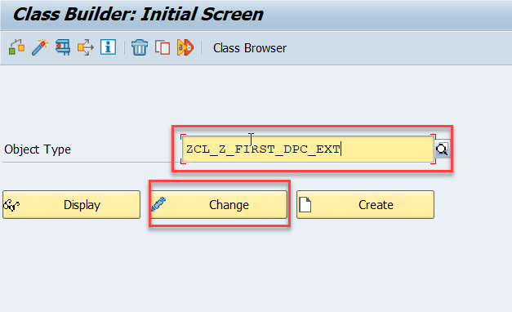
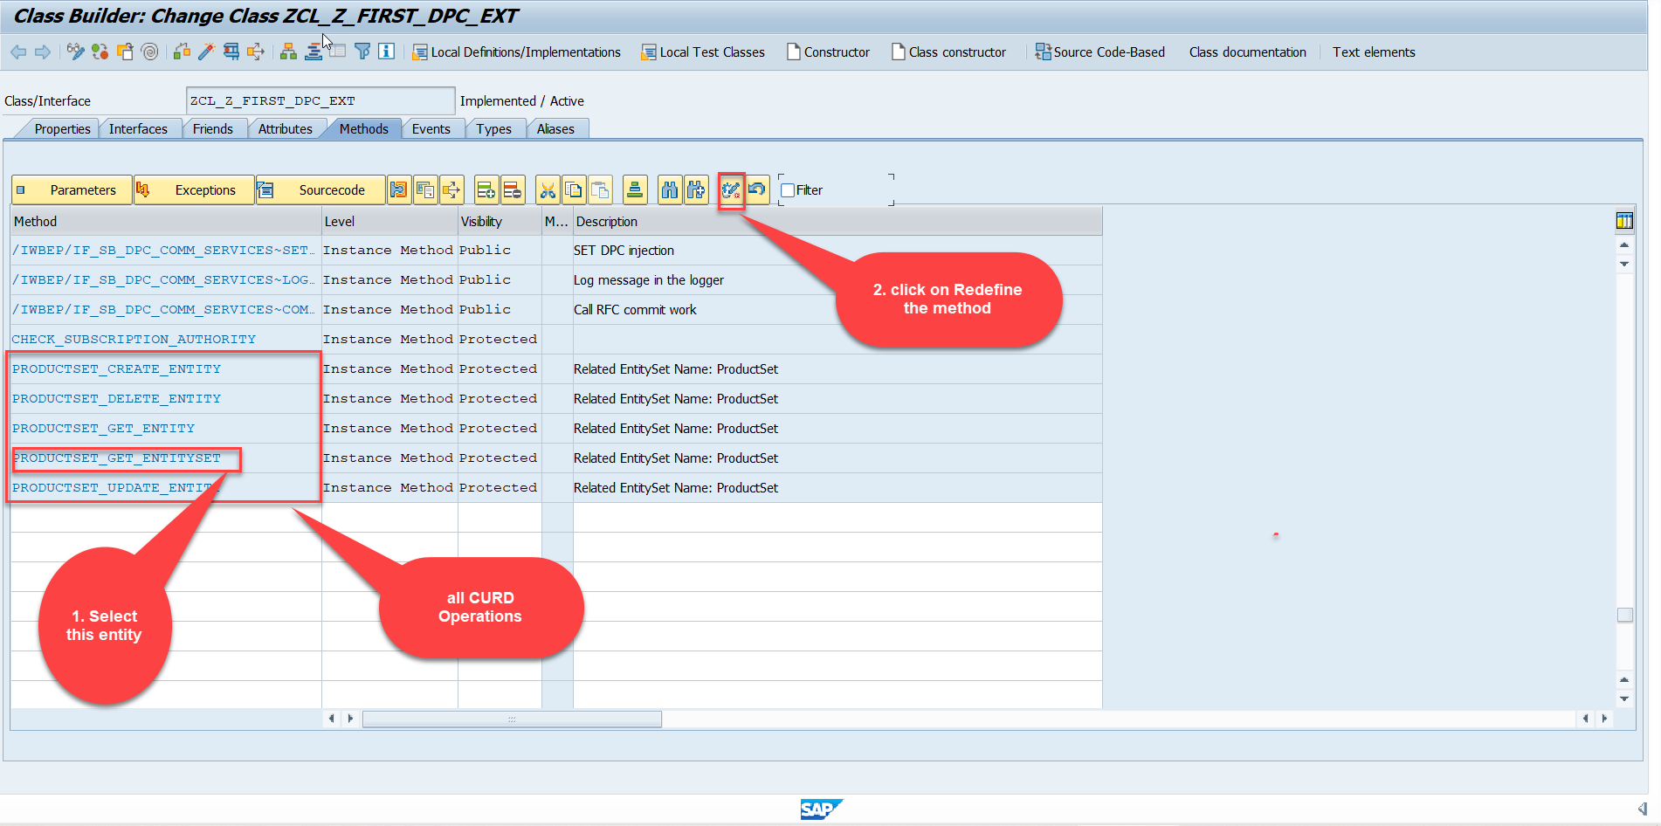
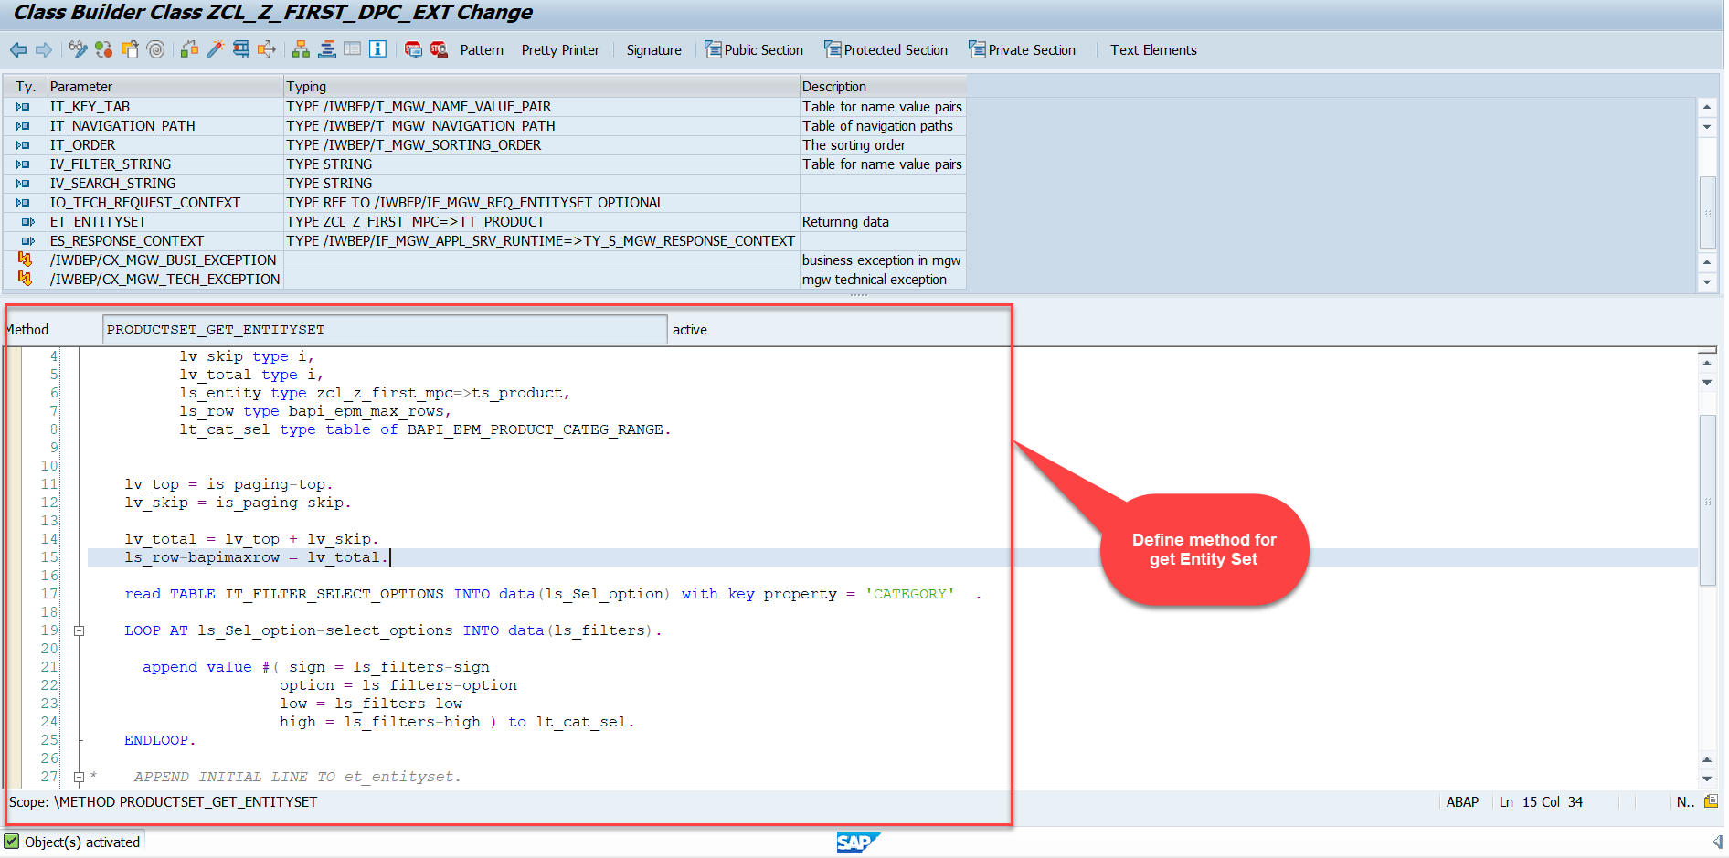
Building Get Entity Set Method for ProductSet
ProductSet Get EntitySet method(with filter, top and skip) in DPC Extension (Class Builder tcode- se24)
After adding the code just activate the service.
Code for PRODUCTSET_GET_ENTITYSET:
GetEntitySet

Slide 16
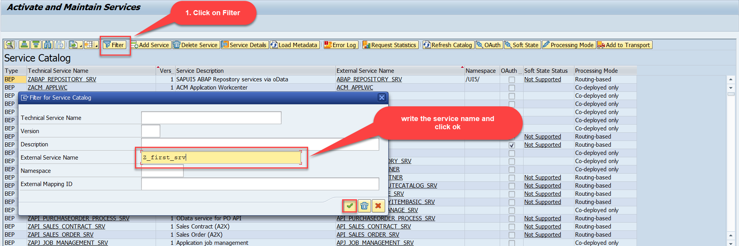
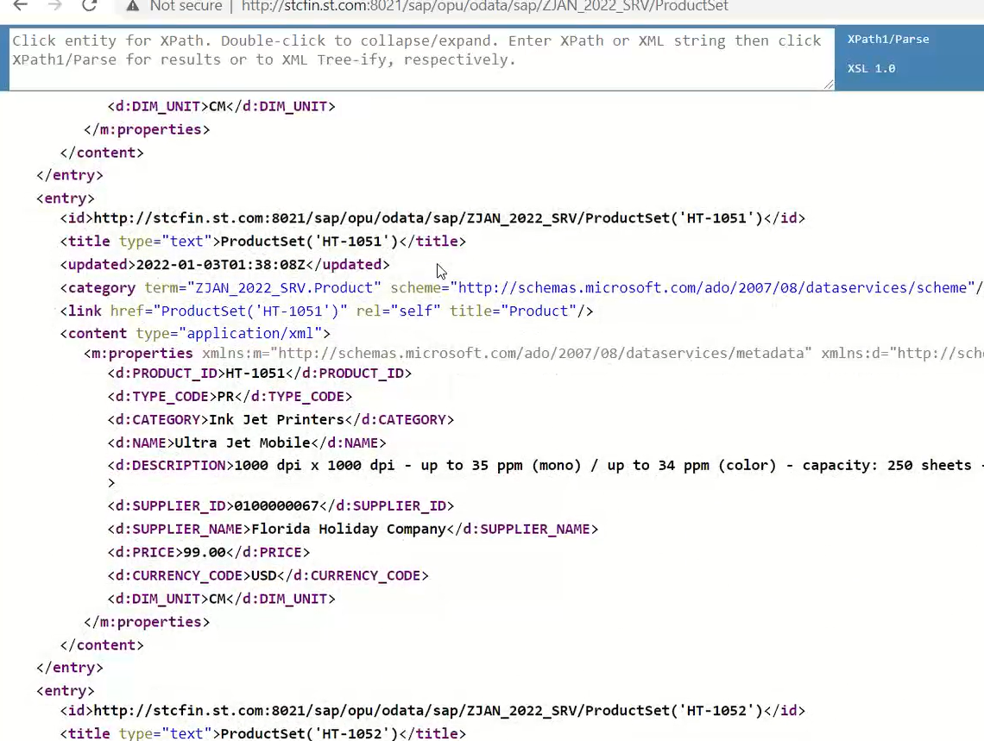
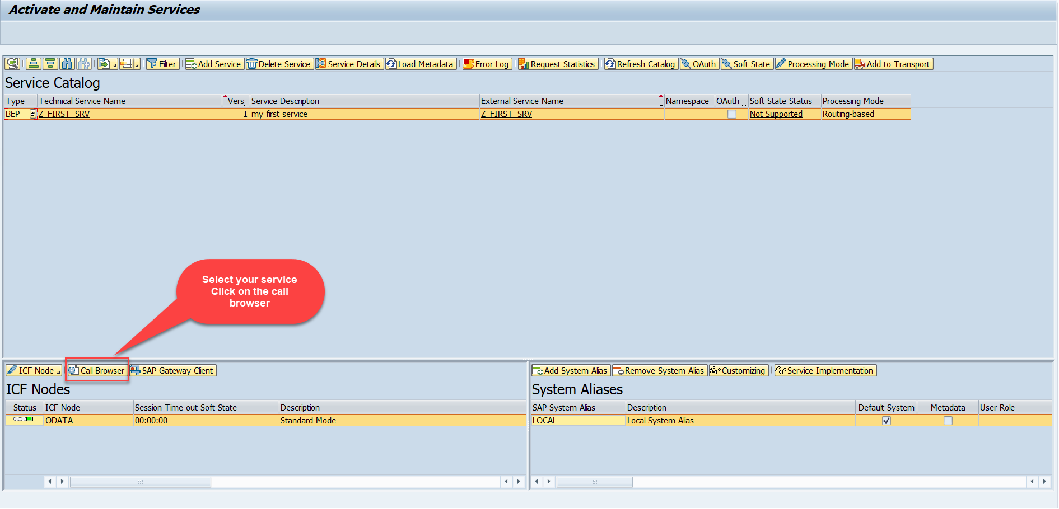
Test the Get Entity Set in Browser
Now enter the Tcode - /n/iwfnd/maint_service and, there search our service using the filter option.
Now select the service and press the Call Browser button to open it in the Browser window.
Just add /ProductSet at the end of the service to call the get product get entity set method
Calling the ProductSet in browser

Slide 17
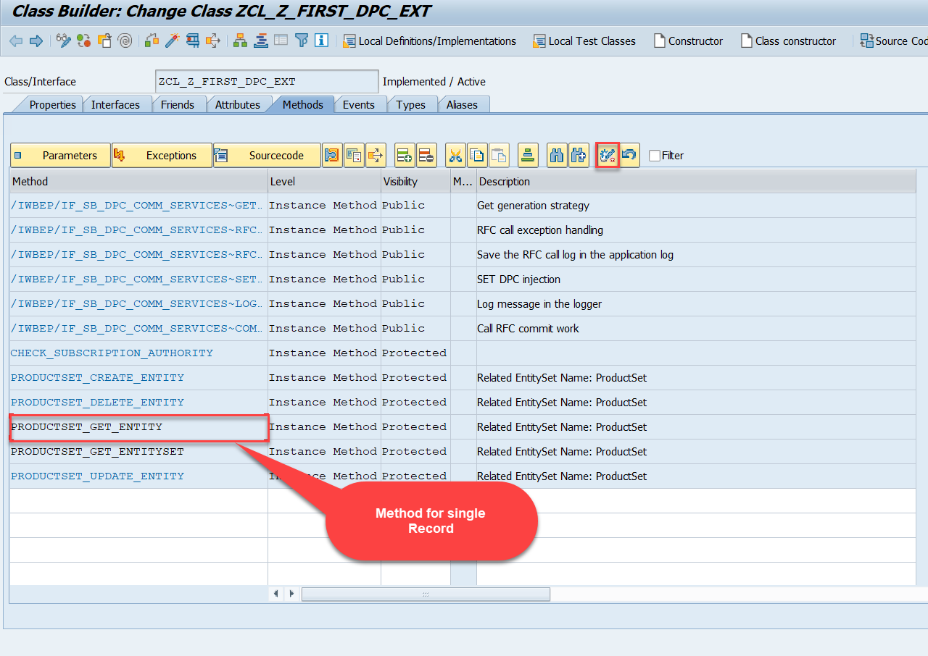
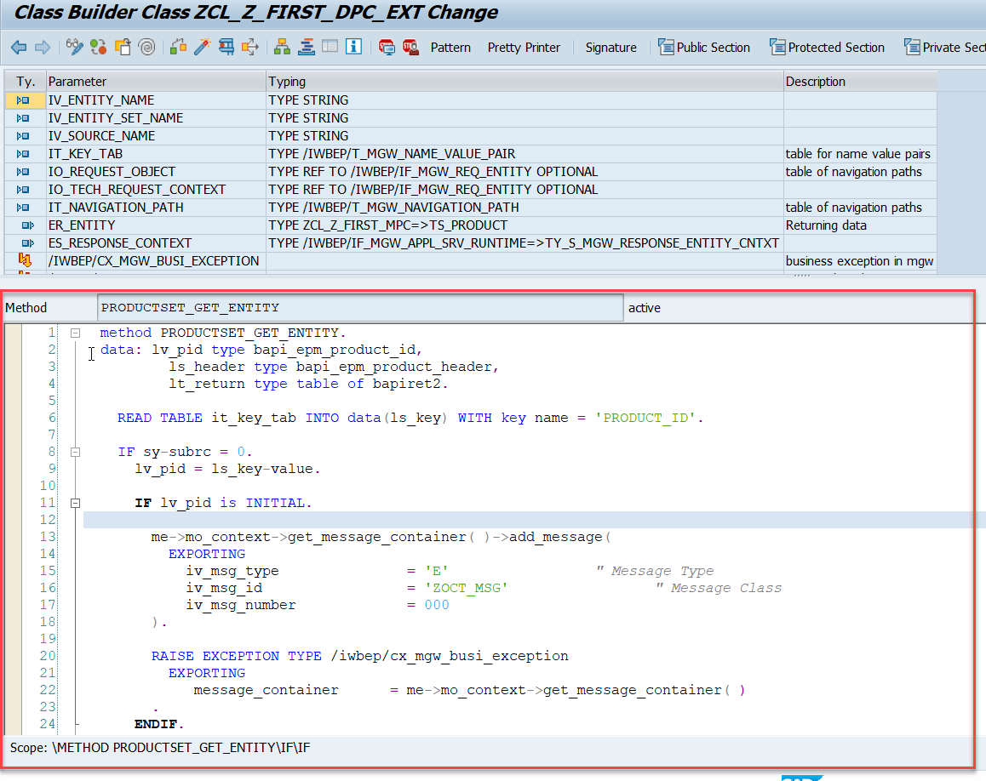
Building Get Entity Method
Go to DPC Extension class of our service and redefine the method PRODUCTSET_GET_ENTITY and put the below provided code.
Code for PRODUCTSET_GET_ENTITY:
GetEntity

Slide 18

Postman
Postman is a free tool which can be used to test any kind of REST/OData Services outside of the system. This allows us to consume the data as if an external consumer would really do.
Postman is an API platform for building and using APIs. Postman simplifies each step of the API lifecycle and streamlines collaboration so you can create better APIs—faster.
As an ABAP developer, you can develop postman collection and deliver it to Fiori Developers for consumption to showcase, what our service is capable of.
Postman can run GET, POST, PUT, PATCH, MERGE, DELETE, and various other request methods as well, and has utilities to help with developing APIs. Free and paid versions are available for Mac, Windows, Linux, and as a Chrome app.
You can Download the postman tool from the link give below: https://www.postman.com/downloads/

Slide 19
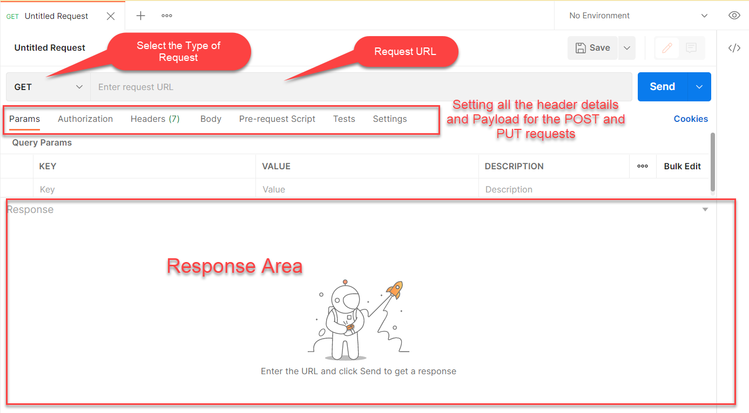
Postman App Layout
The below screen shot shows a basic layout of a request in Postman

Slide 20
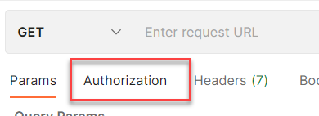
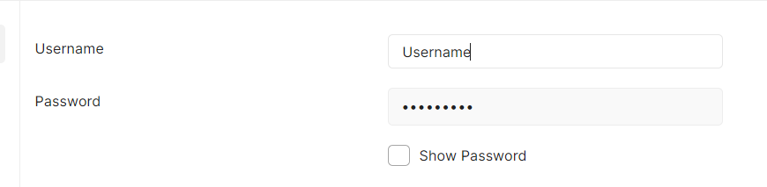
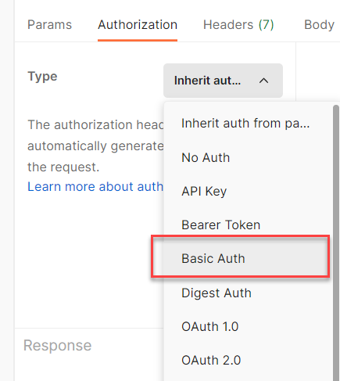
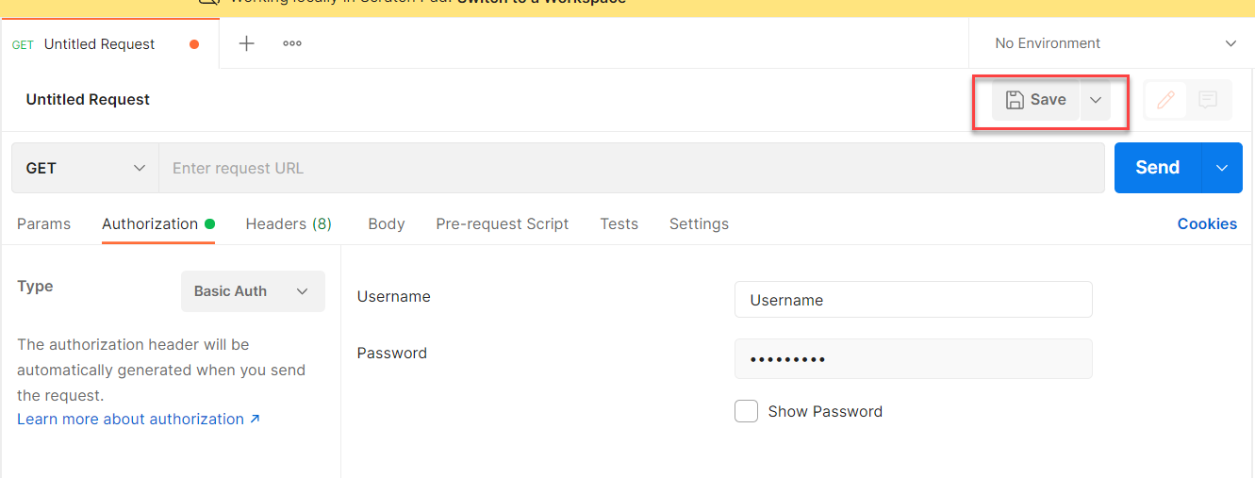
Setting Basic Auth in Postman
Step 1: Go to the Authorization section.
Step 3: Set the Username and Password.
Step 2: Select Basic Auth as Type
Step 4: Save.

Slide 21
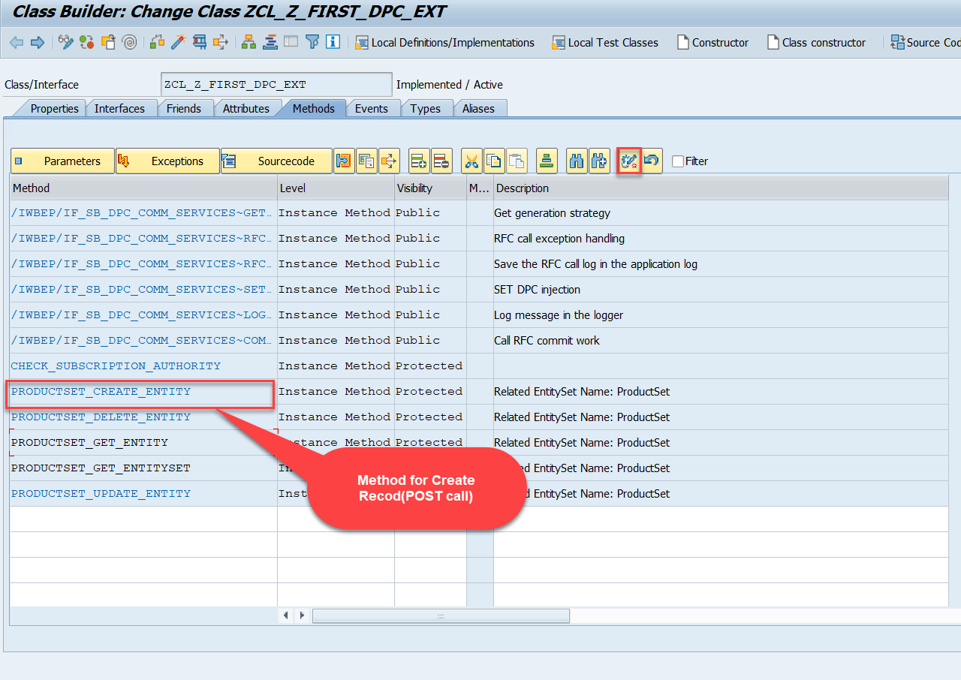
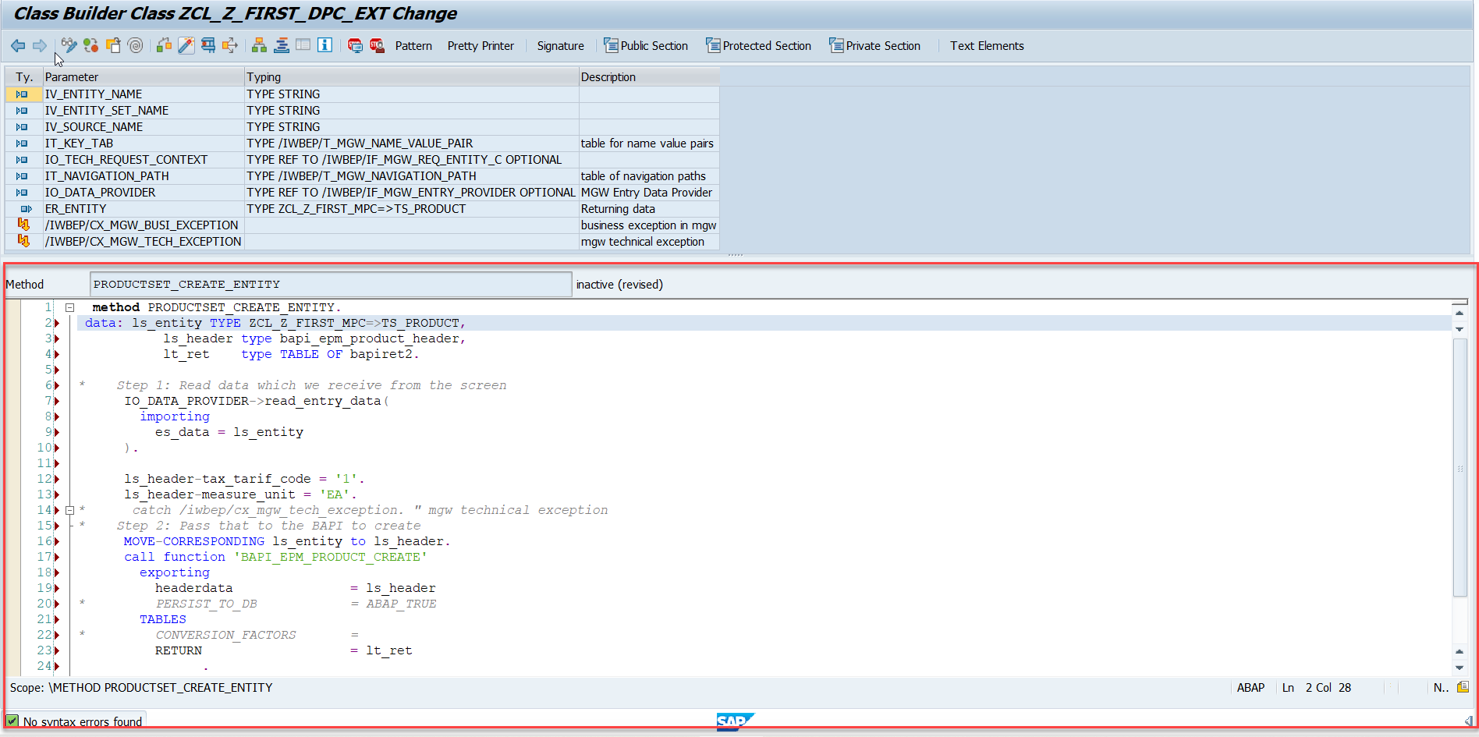
Building CreateEntity(POST) Method
To implement the Create operation in our odata service, go to DPC Extension class of over service and redefine the method PRODUCTSET_CREATE_ENTITY
Code for PRODUCTSET_CREATE_ENTITY: CreateProductEntity

Slide 22
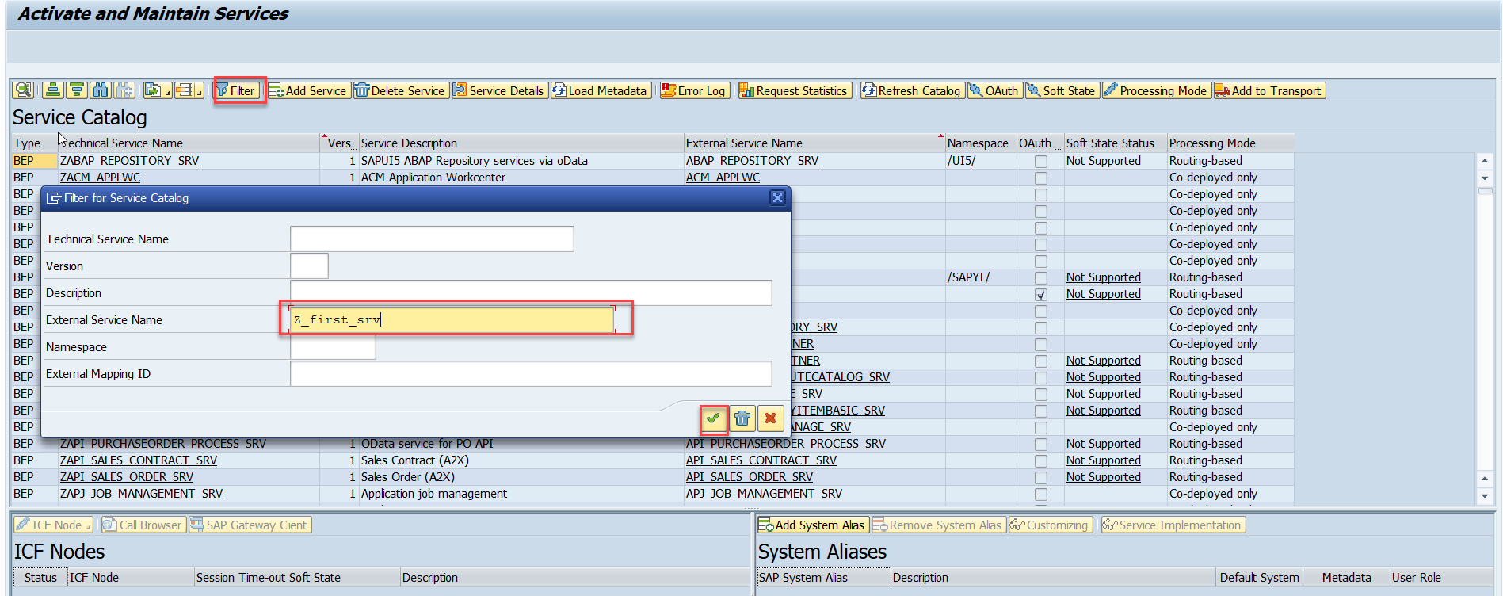
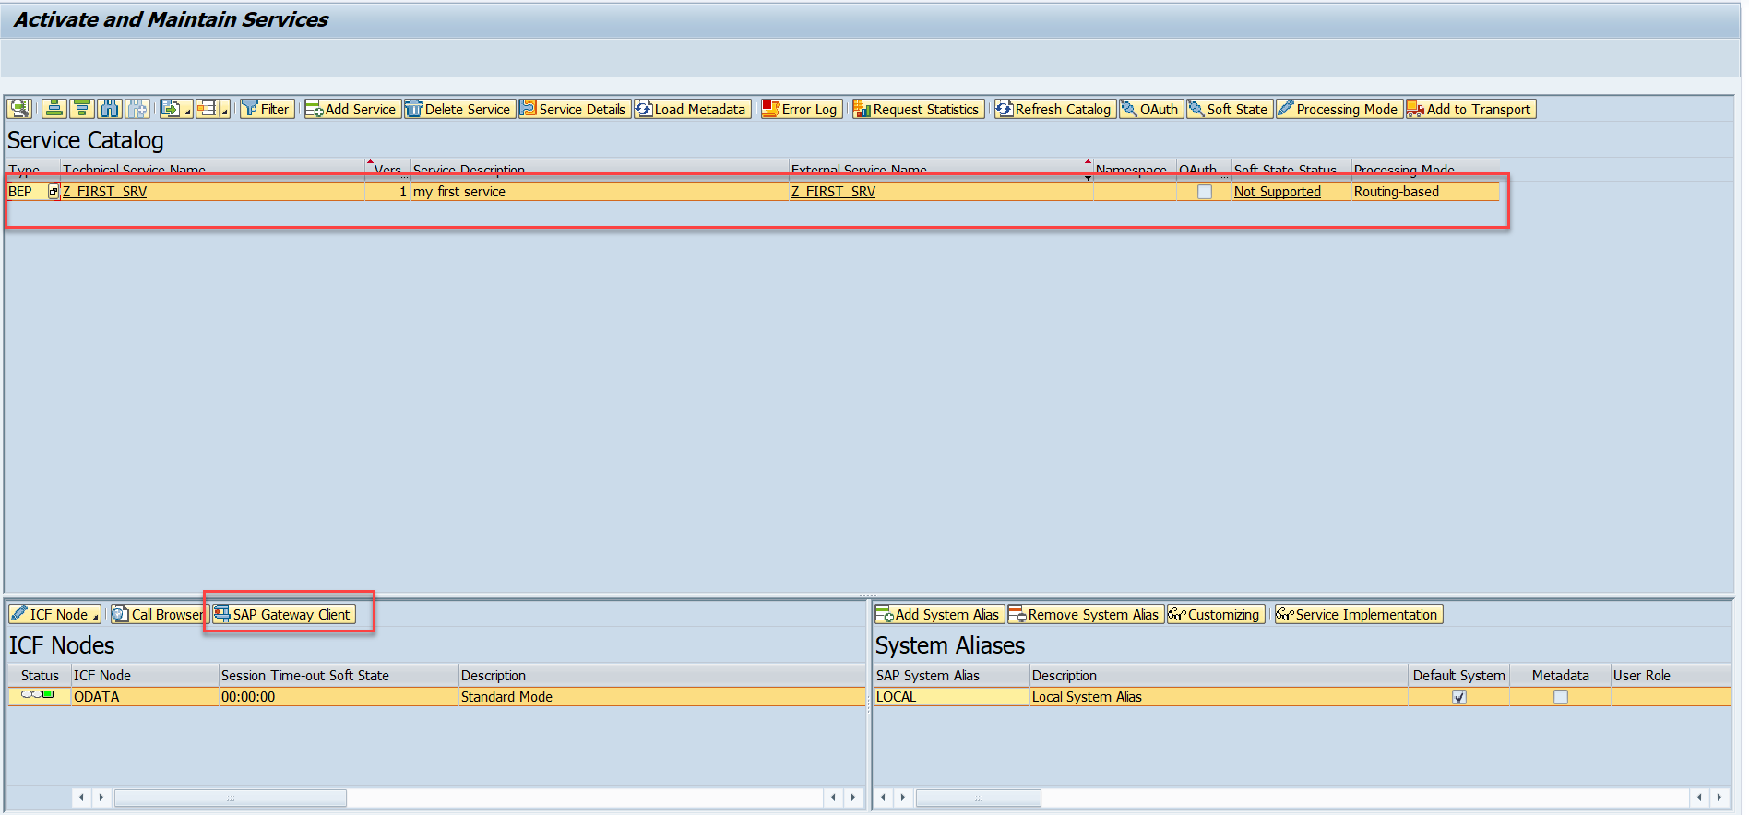
Testing Create Method at Sap Gateway client
Step:1 Go to sap service maintance(tcode- /iwfnd/maint_service) and search for the service and then select the service and click on the sap gateway client

Slide 23
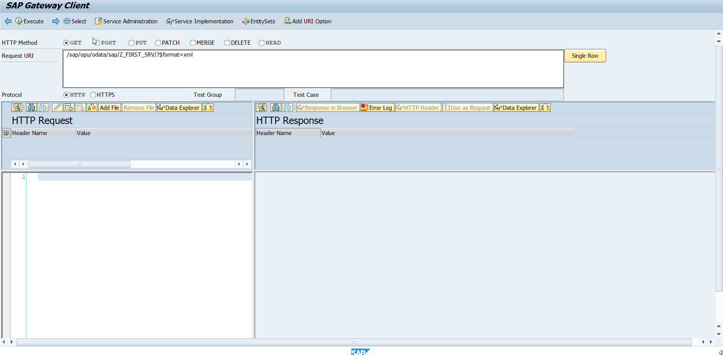
Testing Create Method Continue…
Step:2 Go to sap service maintance(tcode- /iwfnd/maint_service) and search for the service and then select the service and click on the sap gateway client

Slide 24
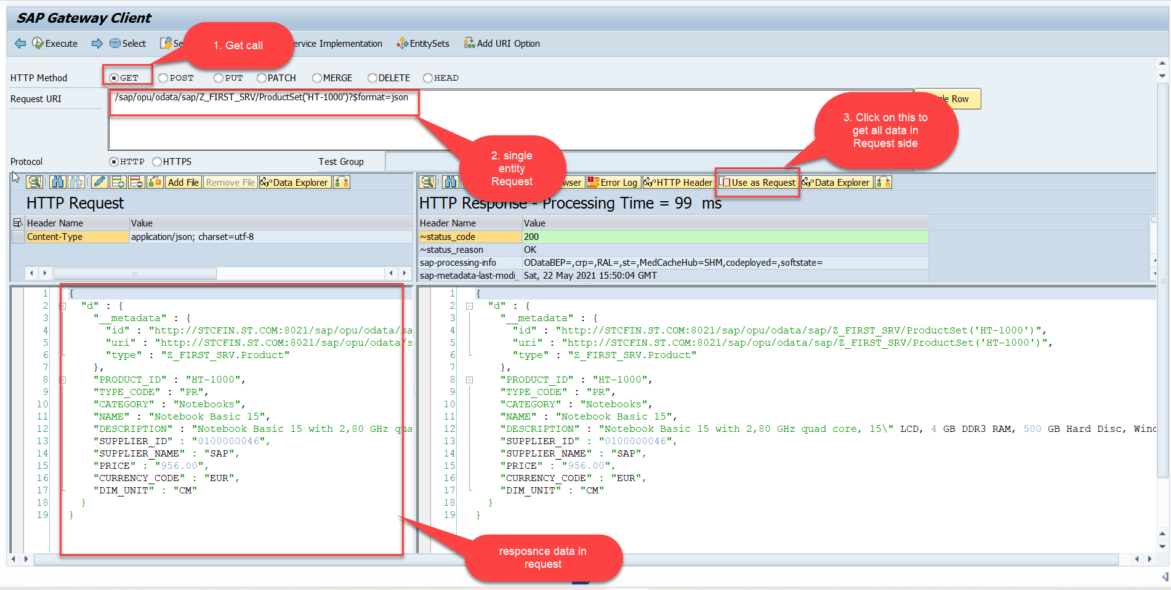
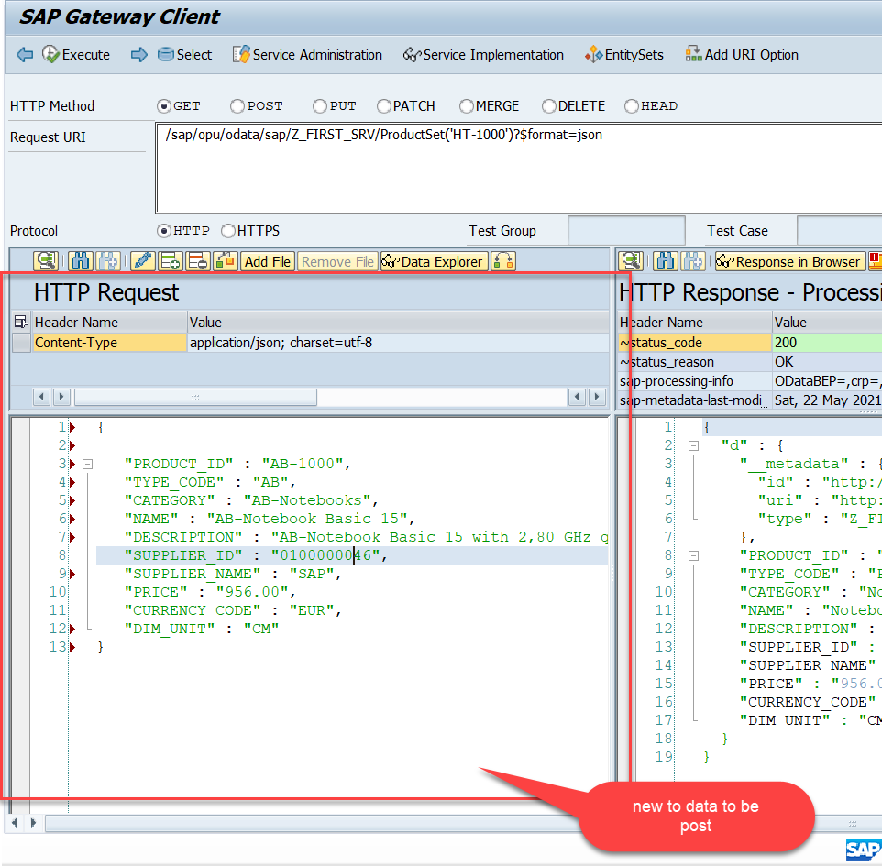
Testing Create Method Continue…
Step:3 Perform a getEntity in the Product set to get the payload to post (/sap/opu/odata/sap/Z_FIRST_SRV/ProductSet('HT-1000')?$format=json) and then clean the data and modify the payload as new.

Slide 25
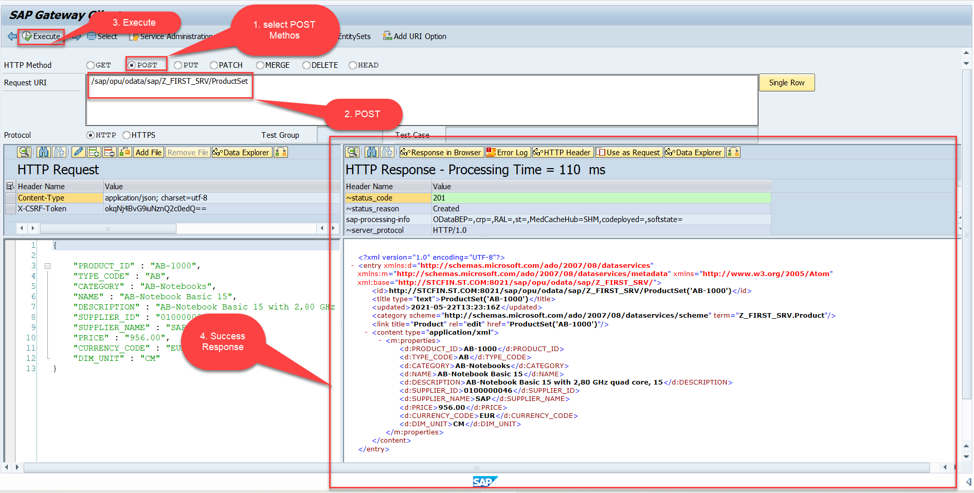
Testing Create Method Continue…
Step:4 send the post request at (/sap/opu/odata/sap/Z_FIRST_SRV/ProductSet)

Slide 26
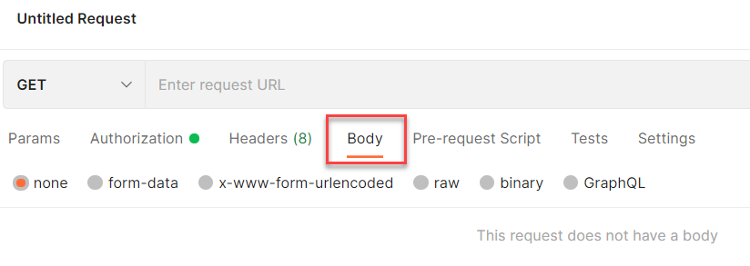
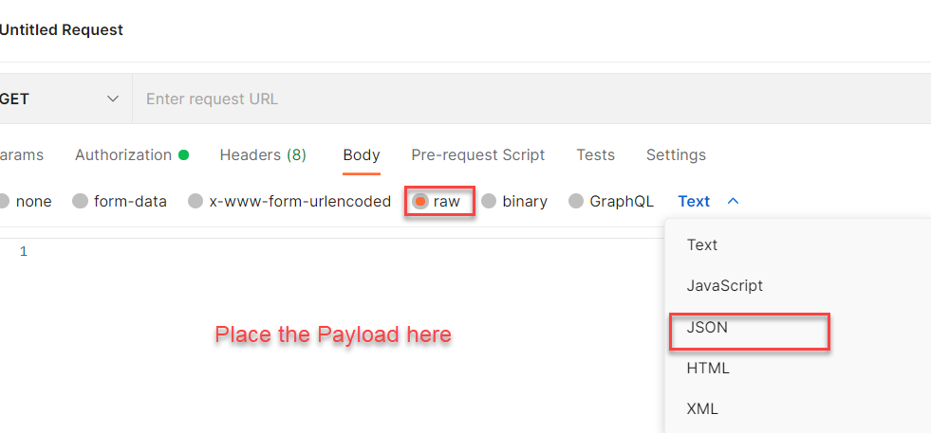
Setting the Payload for POST and PUT request
Step 1: Go to Body Section.
Step 2: Select the raw option form the radio button and then select the data type as JSON.

Slide 27
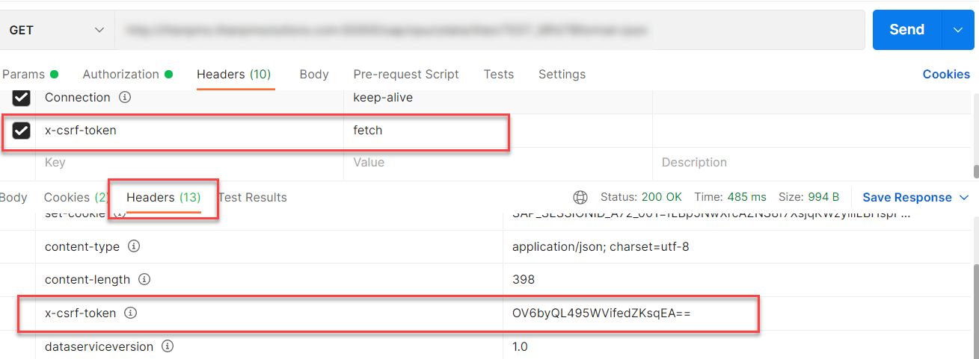
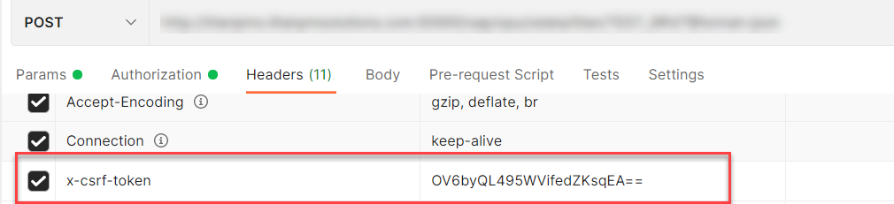
X-CSRF Token
A CSRF Token is a secret, unique and unpredictable value a server-side application generates in order to protect CSRF vulnerable resources.
The tokens are generated and submitted by the server-side application in a subsequent HTTP request made by the client.
Steps to Get the x-csrf token.
To get the x-csrf token we need to pass the value of x-csrf token as fetch with the GET call.
After executing the get call we will find the token in the Header Section of the Response.
- In POST call we need to pass this value of x-csrf token in the header section.

Slide 28
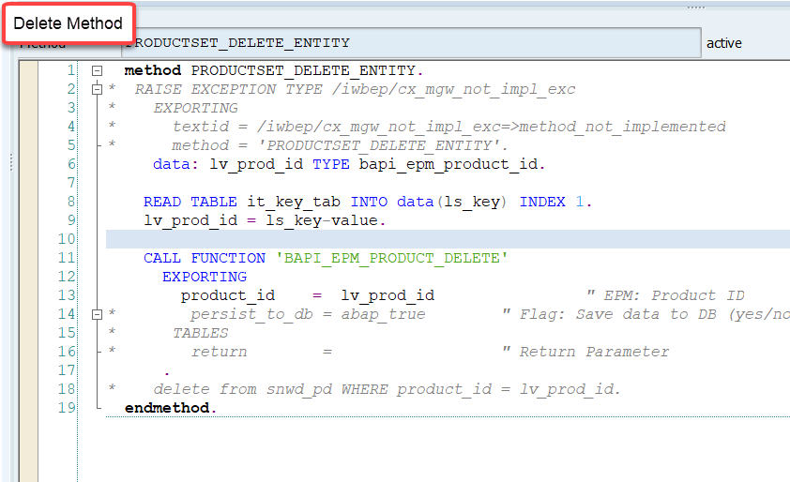
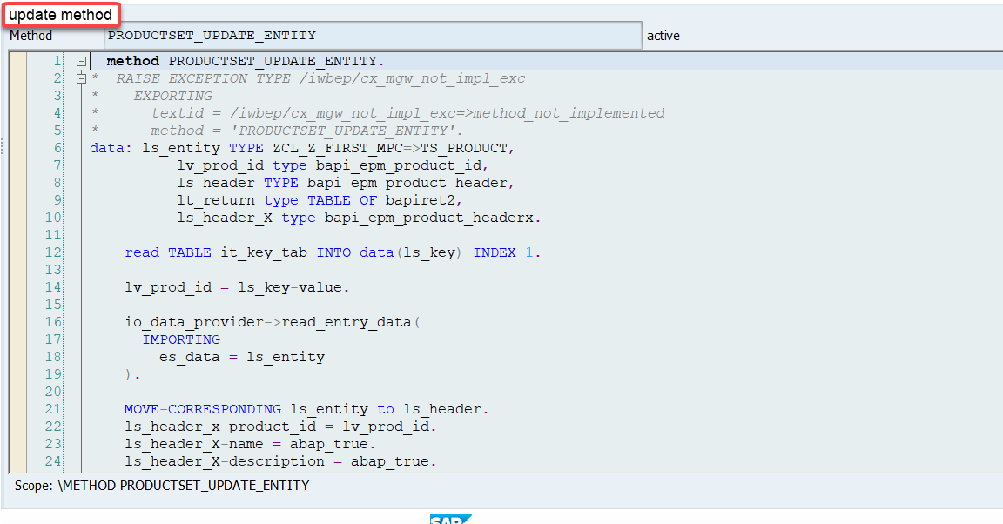
Implementing DELETE and Update (PUT) method
We can implement the delete and update method in the corresponding DPC extension classes.
Code for PRODUCTSET_DELETE_ENTITY: ProductSetDeleteEntity
Code for PRODUCTSET_UPDATE_ENTITY : ProductSetUpdateEntity

Slide 29

End of Day 12

Slide 30

Questions

Slide 31

Anubhav Oberoy

Slide 32


We’re committed to empower you to be
Most Desirable Resource
through powerful training solutions.
We build the workforce of the future.
250+
Corporate Clients
30,000+
Learners Trained
25000+
Learners Placed
FREE WEBINARS
Sign up for free webinars with industry experts every fortnight!
Enroll Now!
Contact us today!
https://anubhavtrainings.com/

Slide 33




More from AnubhavTrainings.com

Slide 34
Title
Content

